Slide 1
MAR 580: Advanced Population Modeling for Management of Living Marine Resources
Lecture 7
Model Building and Model Selection
27 October 2015

Slide 2
Where Are We?
Model Building & Model Selection (Cooch & White 2009, Chapters 4-5)

Slide 3
Today’s Plan
Review
Questions from State-Space Lab?
Comments from CAPAM Data Weighting Meeting?
Review Biomass Dynamics Assignment
Feedback on Project Summaries
Lecture - Model Building & Model Selection (Cooch & White Chapters 4 & 5; Butterworth 2013)
Lab 7
Revisit Lab 2 – mark recapture experiment to estimate survival
Compare models with time invariant and time variant parameters

Slide 4
Frustrations in Modeling
Part of modeling and debugging code is logical and systematic, it also involves exploring hunches.
Best Practices
Data reading – output data and derived variables to check data input and processing.
Simple, separate, understandable statements
Documentation
Diagnose compile problems using error message (line number, error type, …)
Hunches
Simplify model?
Replicate known-answer problems
Make step-wise changes from stable solutions
Take breaks to think and avoid rabbit holes

Slide 5
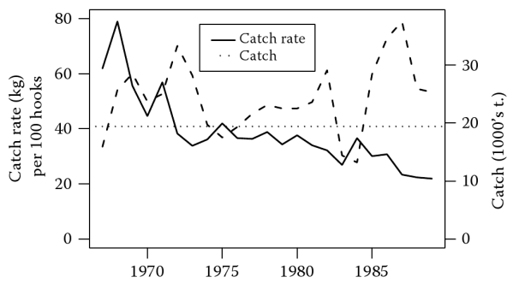
Biomass Dynamics of South Atlantic Albacore
This case study has been widely applied in a series of ‘methods papers’ for estimation:
Polachek et al. (1993)
Effort-averaging models
Process-error models
Observation-error models
Myer & Millar (1999) Bayesian state-space
Thorson & Minto (2015) Mixed-effects state-space
Pedersen & Berg (in review) SPiCT
… and various other production models:
Punt et al. (1995) Age-based production model
Zhang & Kalhoro (2015) Delay Difference model
Brooks et al. (2011) MCMC Guide

Slide 6
Polachek et al (1993)
Applied 3 approaches to case studies and simulated data
Effort-averaging methods assume the stock is in equilibrium and often overestimate MSY despite good fit.
Process-error estimators produce much less reliable estimates than observation-error estimators.

Slide 7
Polachek et al (1993)

Slide 8
Polachek et al (1993)

Slide 9
Polachek et al (1993)

Slide 10
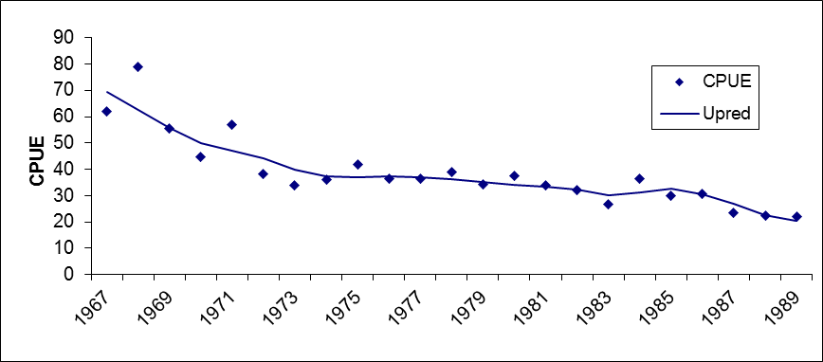
Least Squares – Excel Solver
Log residuals, constraint for B_{t}>0.001kt, estimate q
Generalized Reduced Gradient (GRG2; Lasdon et al. 1978) – numerical iterative, local gradient-based, solution to nonlinear problems
Robust to a wide range of starting values.

Slide 11
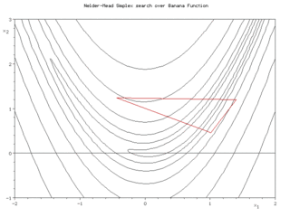
Least Squares – R optim
Nonlinear solution using Nelder & Mead (1965), iterative local gradient algorithm.
Nearly identical solution to Solver that is robust to a wide range of starting values.
Bootstrap analysis suggests
uncertain (but stable)
parameter estimates
Bt/Bmsy
1970 1975 1980 1985 1990

Slide 12
Least Squares – ASPIC (Prager 1994)
Simplex Algorithm based sequential Monte Carlo Search and iterative gradient search; penalty for F>5
Nearly identical solution that is robust to a wide range of starting values.
Plus bootstrap, stochastic projection, model comparisons
Parameter Estimate
B1/K Starting relative biomass (in 1967) 1.099E+00
K Maximum population size 2.302E+02
q(1) CPUE 2.680E-01
MSY Maximum sustainable yield 1.985E+01
Bmsy Stock biomass giving MSY 1.151E+02
Fmsy Fishing mortality rate at MSY 1.725E-01

Slide 13
Bayesian State-Space (Meyer & Millar 1999)
Demonstration of WINBUGS Gibbs sampler for nonlinear fisheries problems.

Slide 14
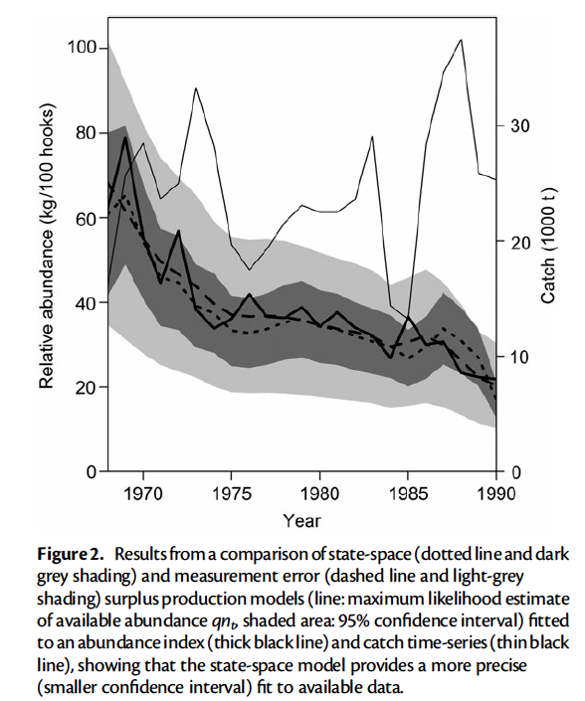
Separable state-space production model
Thorson & Minto (2015)
State-space Schaefer production model fitted to South Atlantic albacore data
Lab 6

Slide 15
SPiCT (Pedersen & Berg, in review)
Stochastic Production model in Continuous-Time
State-space formulation with process and observation errors as random effects

Slide 16
SPiCT (Pedersen & Berg, in review)

Slide 17
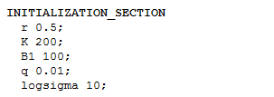
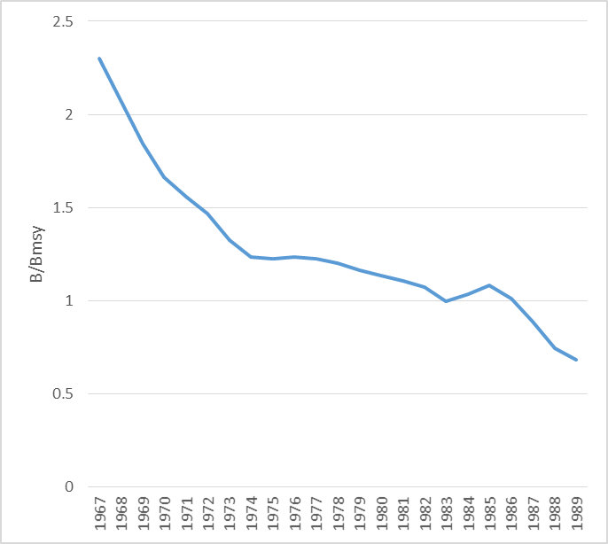
Lab (4) 5 – ADMB S Atl. Albacore - 1 fleet
X
Lab4.tpl
Estimate q (Hilborn & Walters 1992)
Constraint for B_{t}>0.001kt
r
0.308
K
251.602
MSY
19.3833
Bmsy
125.801
Fmsy
0.154079

Slide 18
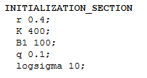
Lab (4) 5 – ADMB S Atl. Albacore - 1 fleet
X
Results insensitive to reasonable starting values
r
0.308
K
251.602
MSY
19.3833
Bmsy
125.801
Fmsy
0.154079
r
0.308
K
251.602
MSY
19.3833
Bmsy
125.801
Fmsy
0.154079
Brooks et al. (2011) MCMC Guide

Slide 19
Lab (4) 5 – ADMB S Atl. Albacore - 1 fleet
X
Generic Improvements from Gavin
Calculate q (Polachek et al. 1993)
Log parameters to avoid <0
Penalty function
dvariable fpen = 0.;
survival = 1.-yield(i)/biomass(i+1);
biomass(i+1) *= posfun(survival,0.01,fpen);
obj_fun += 100*fpen;
Example in ADMB Manual (Fournier 2015, section 2.3)
bio(iy+1)=posfun(bio(iy)+r*bio(iy)*(1.-(bio(iy)/k)),100.0,fpen1);
Avoid clunky if statement, but sensitive to starting values
Need to consider realism of exp(Ln(parameter values))
Small changes in Ln(r), Ln(K), Ln(B1) extend beyond reasonable values.

Slide 20
Lab (4) 5 – ADMB S Atl. Albacore 4 fleets
X
ICCAT (2013)
Extended time series from 1968-1989 to 1956-2011
Captures the beginning of the fishery better (B1~K?)
Provides more dynamic range in exploitation history (post-ICCAT management to end overfishing)
Data from four fleets
Thanks, Chris!

Slide 21
Lab (4) 5 – ADMB S Atl. Albacore 4 fleets
X
More CPUE time series offers more data but
also requires more parameters (q for each fleet)
many missing values
conflicting signals!
Both versions of ADMB
Ln parameters with penalty and calculated q,
untransformed parameters with constraint and estimated q
… are not estimating the Hessian matrix because the covariance matrix is still not positive definite ☹ - yet!

Slide 22
ASPIC (ICCAT 2013)
2 production functions (Logistic or Gompertz)
2 data weightings (equal or by catch).

Slide 23
ASPIC (ICCAT 2013)
Sensitivity to starting year assumption and CPUE data selection

Slide 24
ASPIC (ICCAT 2013)
Retrospective analysis

Slide 25
Bayesian Surplus Production Model (ICCAT 2013)

Slide 26
Bayesian Surplus Production Model (ICCAT 2013)

Slide 27
Bayesian Surplus Production Model (ICCAT 2013)

Slide 28
Bayesian Surplus Production Model (ICCAT 2013)

Slide 29
Bayesian Surplus Production Model (ICCAT 2013)

Slide 30
Bayesian Surplus Production Model (ICCAT 2013)

Slide 31
ICCAT (2013) Among ‘Model’ Uncertainty
Model: Logistic Gompertz Logistic Gompertz
Data: Equal weights Equal weights Catch weights Catch weights

Slide 32
Today’s Plan
Review
Questions from State-Space Lab?
Comments from CAPAM Data Weighting Meeting?
Review Biomass Dynamics Assignment
Feedback on Project Summaries
Lecture - Model Building & Model Selection (Cooch & White Chapters 4 & 5)
Lab 7
Revisit Lab 2 – mark recapture experiment to estimate survival
Compare models with time invariant and time variant parameters

Slide 33
Fishery Science & Management
Fishery Management (objectives)
Stock Status
Management Advice
Management Actions
(catch limits, gear/size limits)
Stock Assessment
(estimate stock size, F and reference points)
Estimated Catch
Age/Size composition
Fishery
(effort, selectivity)
Surveys
Relative Abundance
Age/Size composition
Fishing Mortality
Catch
Resource
(abundance & biomass;
survival, growth, recruitment)

Slide 34
Among ‘Model’ Uncertainty
Model: Logistic Gompertz Logistic Gompertz
Data: Equal weights Equal weights Catch weights Catch weights

Slide 35
Model Building and Selection
Formal Model Selection
Model validation
Parsimony (AIC, DIC, BIC, cross-validation, …)
Comparison of nested simple and complex models
Limitations to formal model selection
Selection of ‘Best Model’
Multi-Model Inference
Robust Management Procedures (thanks to Doug Butterworth)

Slide 36
Step 1. Data Inventory & a Priori Evaluation
Consider all available information
Evaluate representativeness (and population of inference?)
Sampling design?
Standardized protocol?
Post-hoc standardization?
Uncertainties (biases? precision?)
Time series? Quality changes
Conventional data (catch, CPUE, surveys)
Unconventional data (tagging, environmental covariates?)

Slide 37
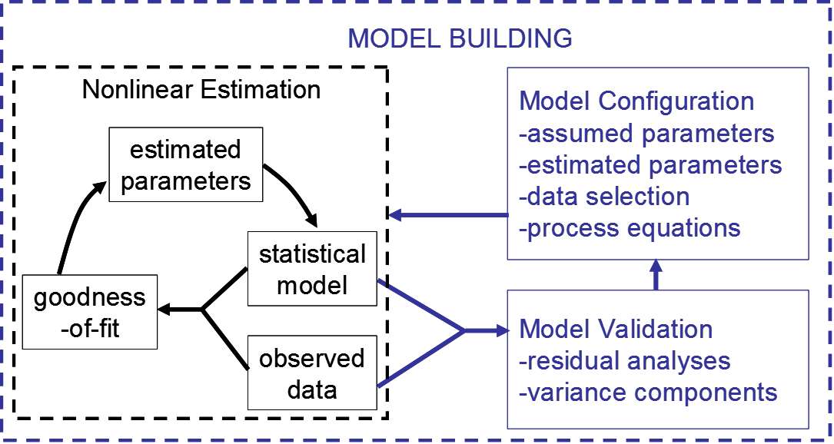
Step 2. Model Building (multiple approaches)

Slide 38
Step 3. Model Validation
Statistical diagnostics - residual analyses (searching for nonrandom patterns and deviations from assumed distributions)
Sensitivity analyses (alternative configurations with plausible assumptions)
Retrospective analysis (successively delete terminal year of data)
Simulation testing (generic and tailored to the application of interest)

Slide 39
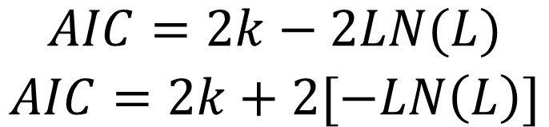
Measures of Parsimony
More parameters always improve the model fit, but additional parameters may be ‘overfitting’ (fitting to noise in sample data rather than signal in sampled population)
Akaike information criterion (AIC) is a measure of parsimony (explaining the data with as few parameters as possible)
k: number of estimated parameters
L: likelihood of model parameter values given data
Lower values of AIC indicate greater parsimony
AIC = N*log(RSS/N) + 2k
$$\begin{matrix}AIC=2k−2LN(L) \\ AIC=2k+2[−LN\left(L\right)]\end{matrix}$$

Slide 40
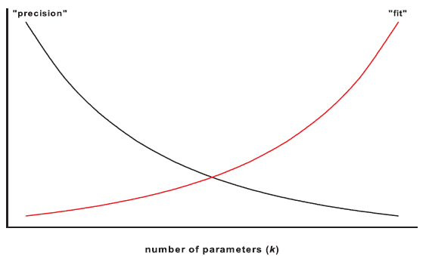
Model Selection
AIC provides the optimal balance between goodness-of-fit and parsimony.

Slide 41
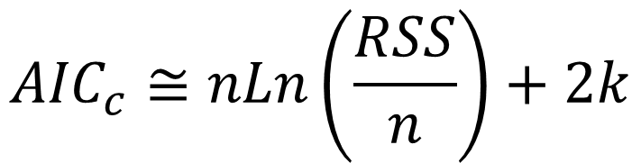
Measures of Parsimony
Akaike information criterion (AIC) approximation for least squares:
k: number of estimated parameters
L: likelihood of model parameter values given data
n: sample size
Assuming normally distributed error
$${AIC}_{c}≅nLn\left(\frac{RSS}{n}\right)+2k$$

Slide 42
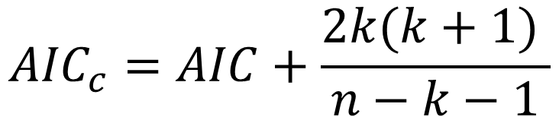
Measures of Parsimony
AIC is based on information theory, assuming asymptotic sample size.
AIC_{c}: ‘corrected AIC’ adjusts for finite sample size (assuming a linear model with normal variation)
n: sample size
AIC_{c} increases the penalty for additional parameters when sample size is low.
AIC_{c} is appropriate for mark-recapture or tag-recovery, but not for integrated stock assessment. Why?
$${AIC}_{c}=AIC+\frac{2k(k+1) }{n−k−1}$$

Slide 43
Cross-Validation
Estimate model parameters using a subset of the available data (‘intrinsic data’).
Compare model predictions to another subset of data that is not used to estimate model parameters (‘extrinsic data’).
More complex models will always fit the intrinsic data better, but additional parameters that do not improve fit to extrinsic data may be fitting to ‘noise’ (idiosyncrasies of the intrinsic data)

Slide 44

Formal Model Selection
Cooch & White (Chapters 4 & 5) disciples of Burnham & Anderson (2009)

Slide 45
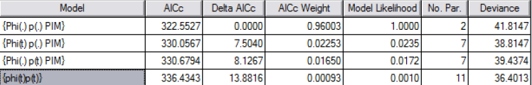
Model Selection
Survival and capture probability (Φ, p) can be constant (.) or differ over time (t).
Alternative models can be compared by goodness-of-fit (deviance), parsimony (# parameters) and both (AICc)

Slide 46
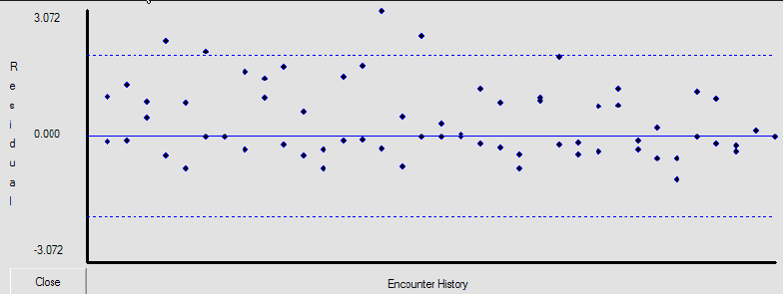
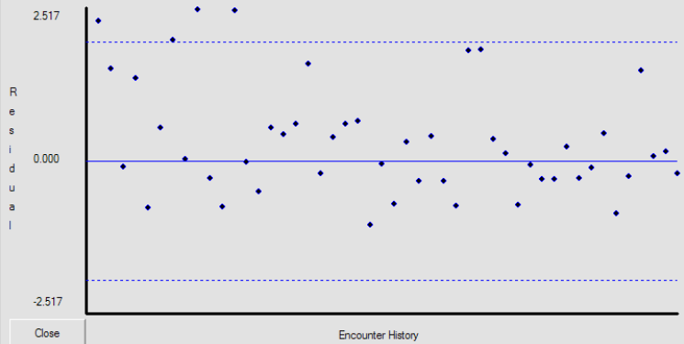
Goodness-of-Fit
Likelihood and deviance measure goodness-of-fit.
Residual analysis detects trends, symmetry and dispersion.

Slide 47
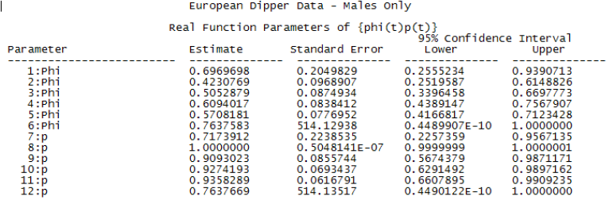
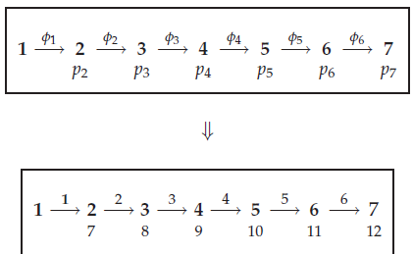
Model Fitting
Time-varying survival (Φ) and capture probability (p)

Slide 48
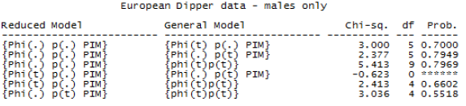
Model Comparison
Likelihood ratio tests are used to evaluate improvement from simple models nested in more complex models.

Slide 49
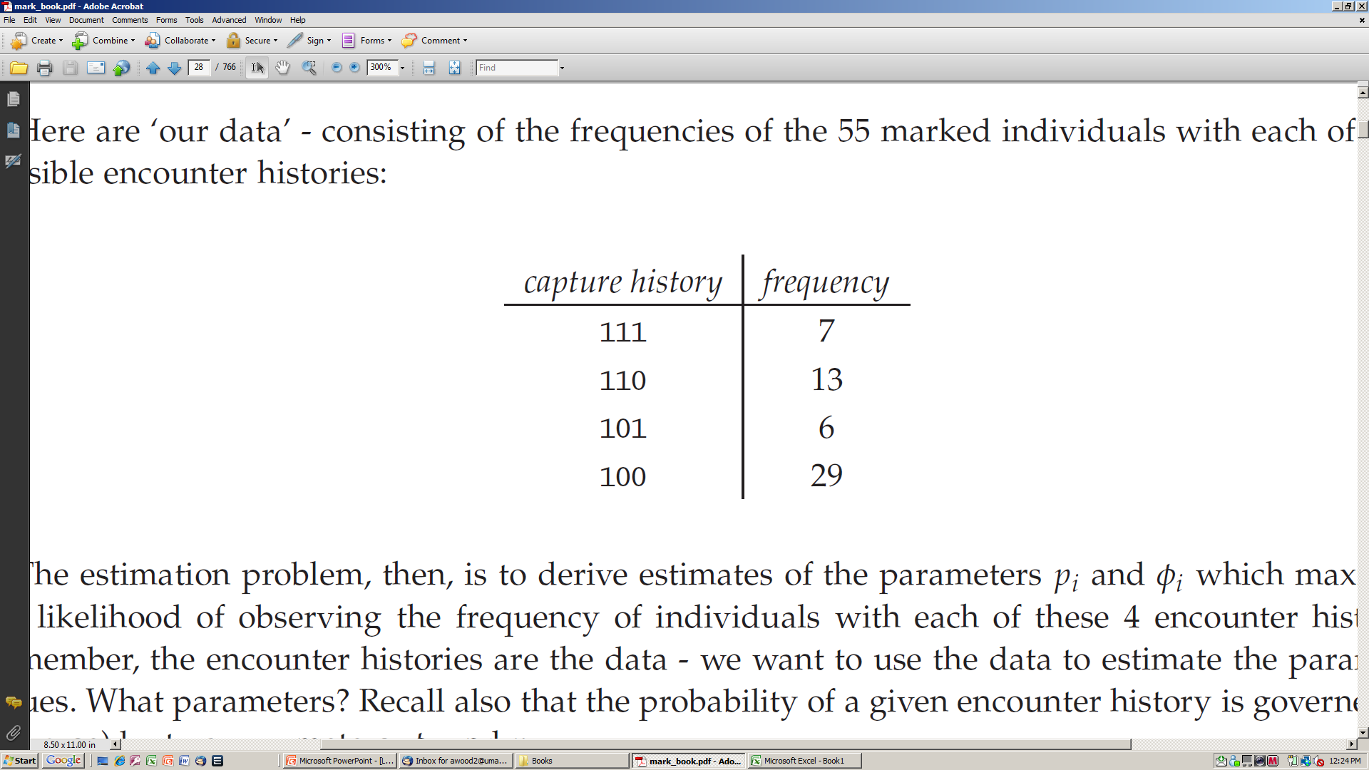
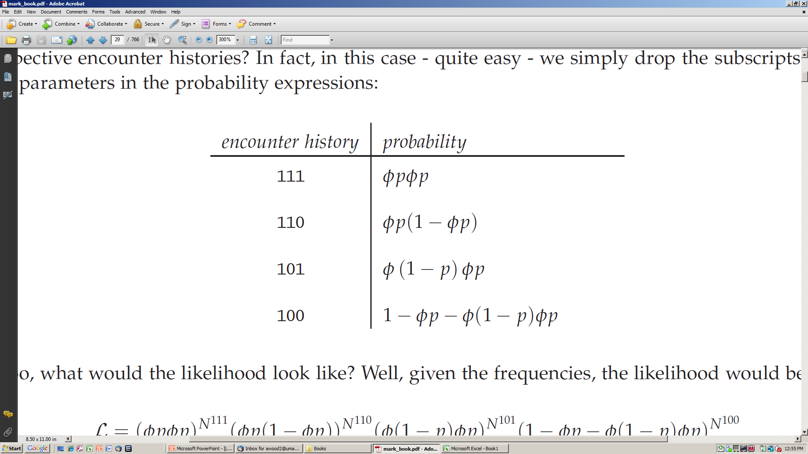
Mark-Recapture Application from Lab 2
Ssurvival parameter is estimating the “success” (probability) of surviving (Φ) over a given time period (or dying, 1- Φ), along with the probability of capture (p).

Slide 50
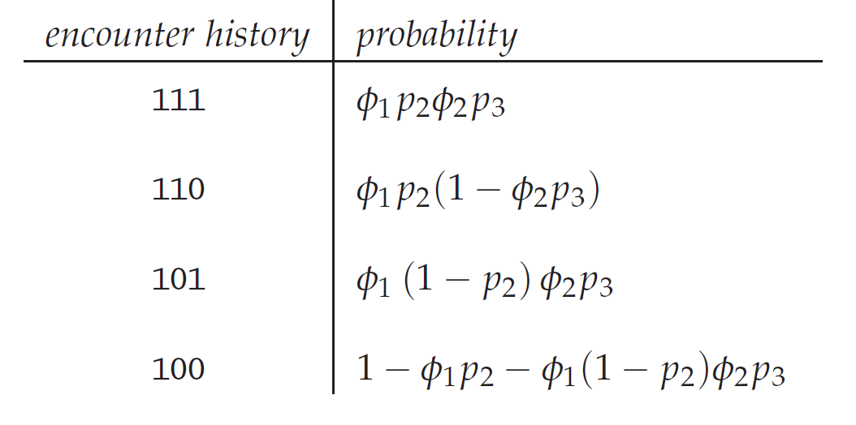
Mark-Recapture Application
The problem gets more complicated if survival and probability of capture change over time(Φ_{t}, p_{t}).

Slide 51
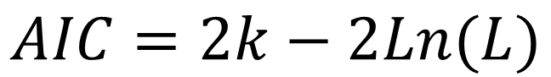
Limitations of Formal Model Selection
AIC can be used to identify the most parsimonious model(s), and multi-model inference can be based on model likelihoods:
AIC is only for valid models (no residual patterns, mis-specifications, error structure…)
AIC can only compare alternative models that explain the same data.
AIC can only compare models with comparable likelihoods.
$$AIC=2k−2Ln(L)$$

Slide 52
ICCAT (2013) Among ‘Model’ Uncertainty
Model: Logistic Gompertz Logistic Gompertz
Data: Equal weights Equal weights Catch weights Catch weights

Slide 53
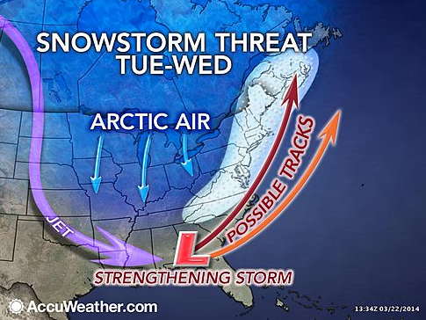
Ensemble Analysis

Slide 54
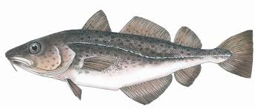
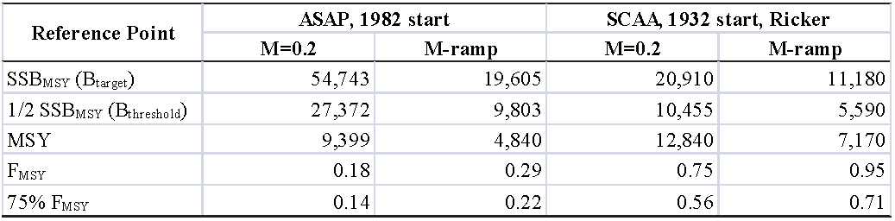
Gulf of Maine Cod
Several alternative states of nature based on natural mortality, the stock-recruitment relationship, and the starting year were considered to be plausible but had substantially reference point and stock status implications.
NEFSC 2012

Slide 55
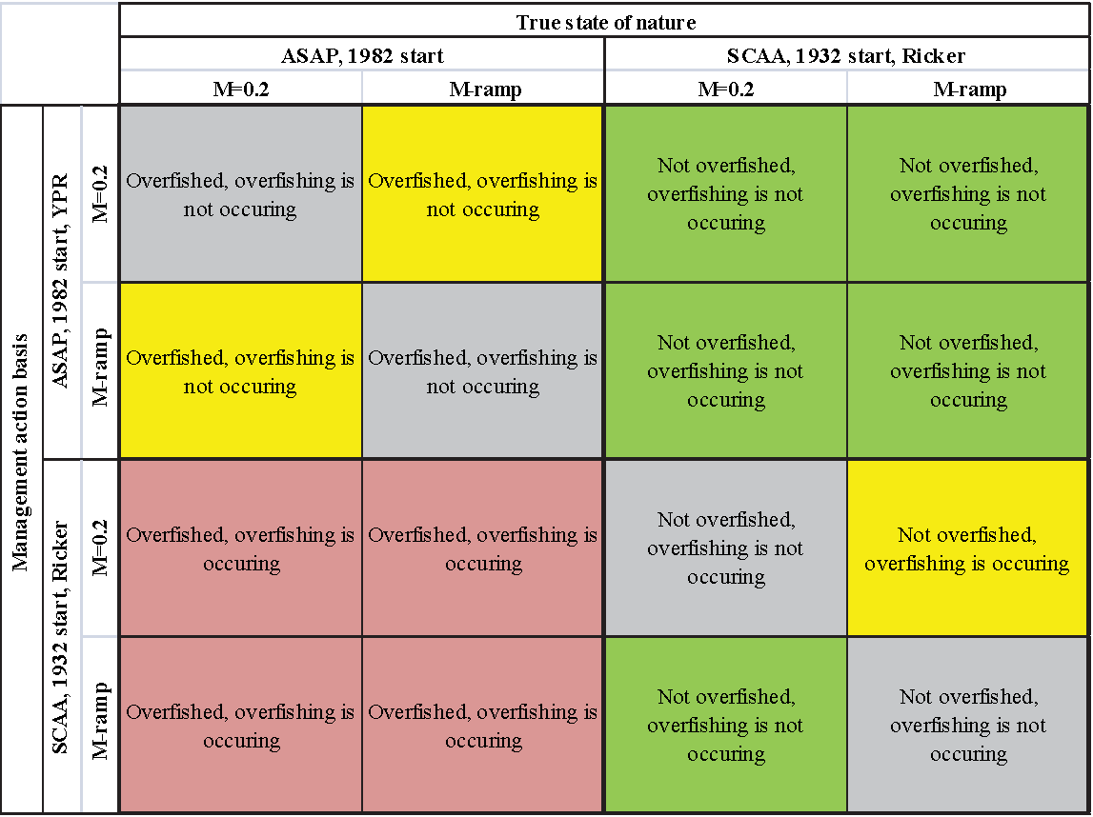
Gulf of Maine Cod
A ‘consequence analysis’ was communicated to peer reviewers for stock status.
NEFSC 2012

Slide 56
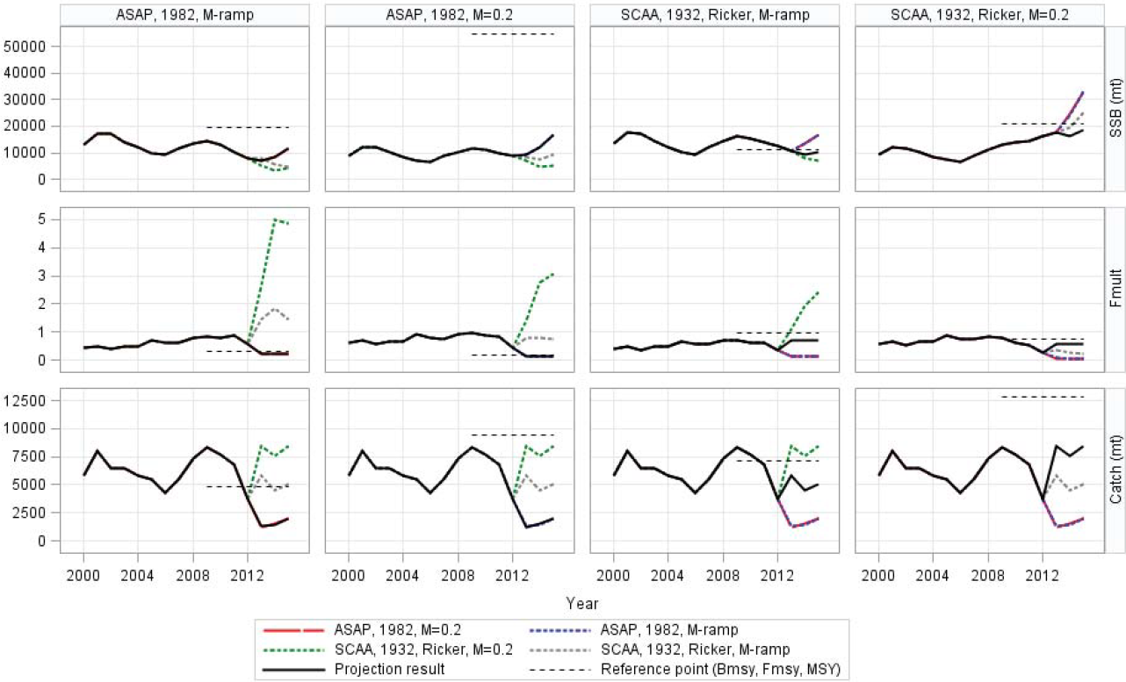
New England Cod
‘Consequence analysis’ for projections.
REJECTED BY PEER REVIEW (instructed to select a best model)
NEFSC 2012

Slide 57
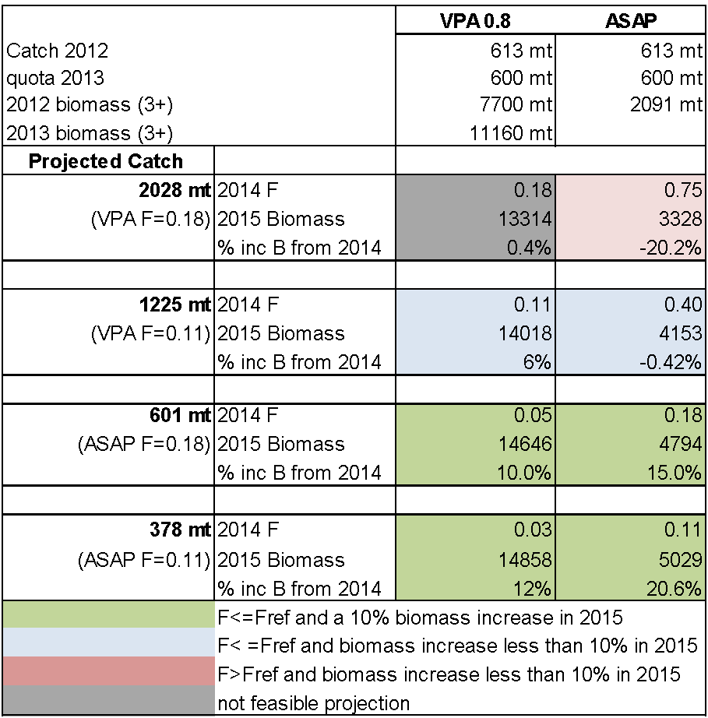
Eastern Georges Bank Cod
A consequence analysis was communicated to managers for from two models with different natural mortality of the oldest age.
TRAC 2013

Slide 58
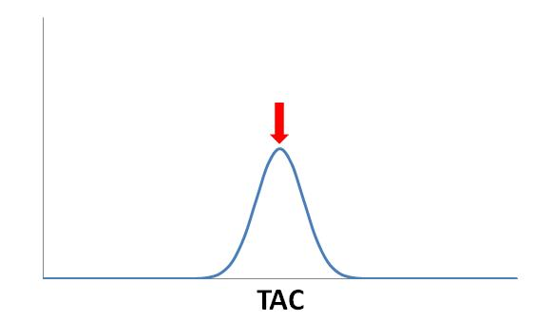
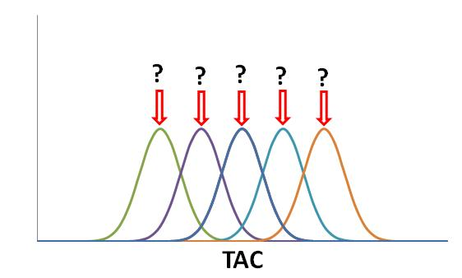
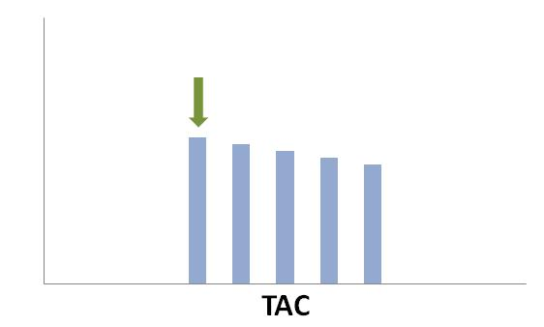
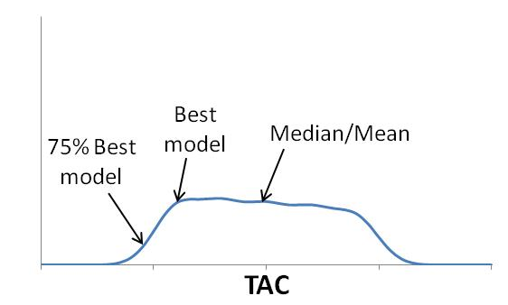
Considering Multiple Models
Single assessment
Multiple competing models
Relative weights
TAC probability distribution
Best model
Butterworth 2013

Slide 59
Empirical Management Procedures
Constant catch MP:
Slope MP:
Target MP:
(I = index of abundance available annually)
Butterworth 2013

Slide 60
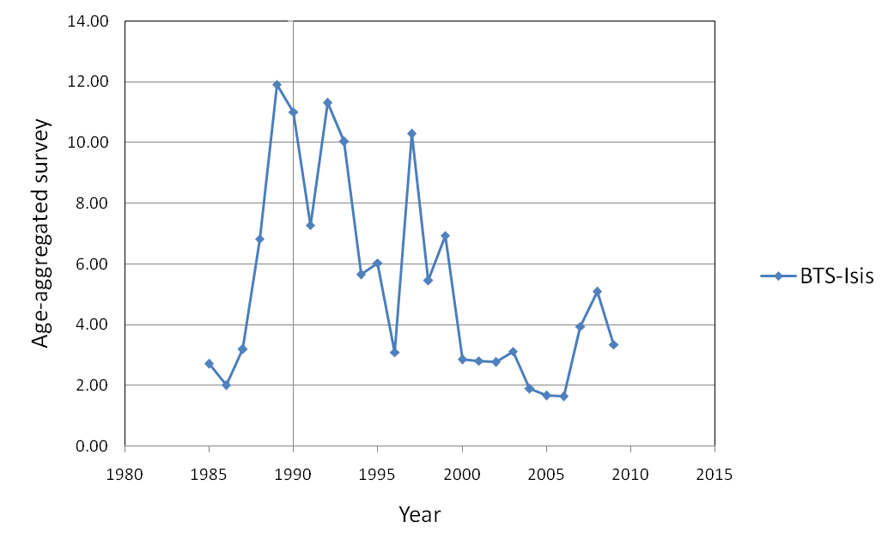
Empirical Management Procedures
Butterworth 2013

Slide 61
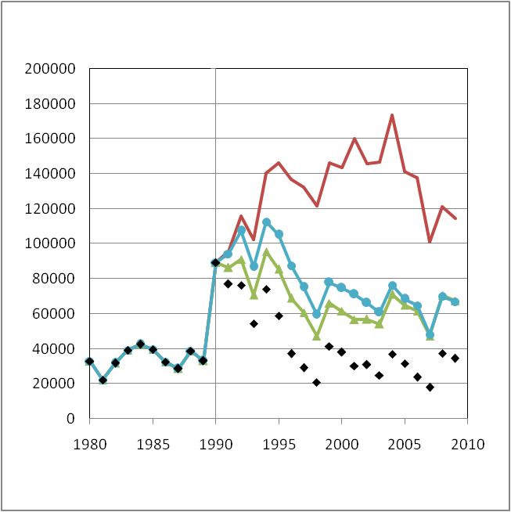
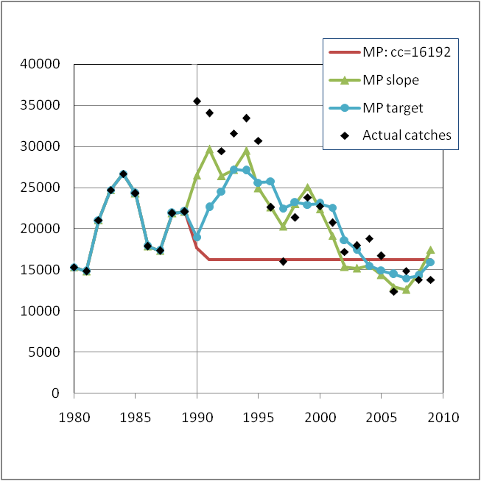

Empirical Management Procedures - Performance of Management Procedure evaluated using each plausible model.
Spawning biomass (tons)
Annual catch (tons)

Slide 62
Lab 7
Apply alternative models with time-invariant and time-varying parameters.
Compare models and interpret results.
Submit a short report and results files by November 3

Slide 63
Where Are We Going?
Next Week – Reference Point Estimation (Bolker 2008, Chapter 5)

